Slide 1
Module 6 plan risk responses
Mgmt 6062 - Project Risk and Quality

Slide 2
Module agenda
Plan Risk Responses
Sochi 2014 Olympics Project
Objectives and inputs for planning risk responses
How to plan risk responses
Options for risk response
Risk owners
Contingency plans
Fallback plans
Triggers
Reserves
Homework/evaluation(s)

Slide 3
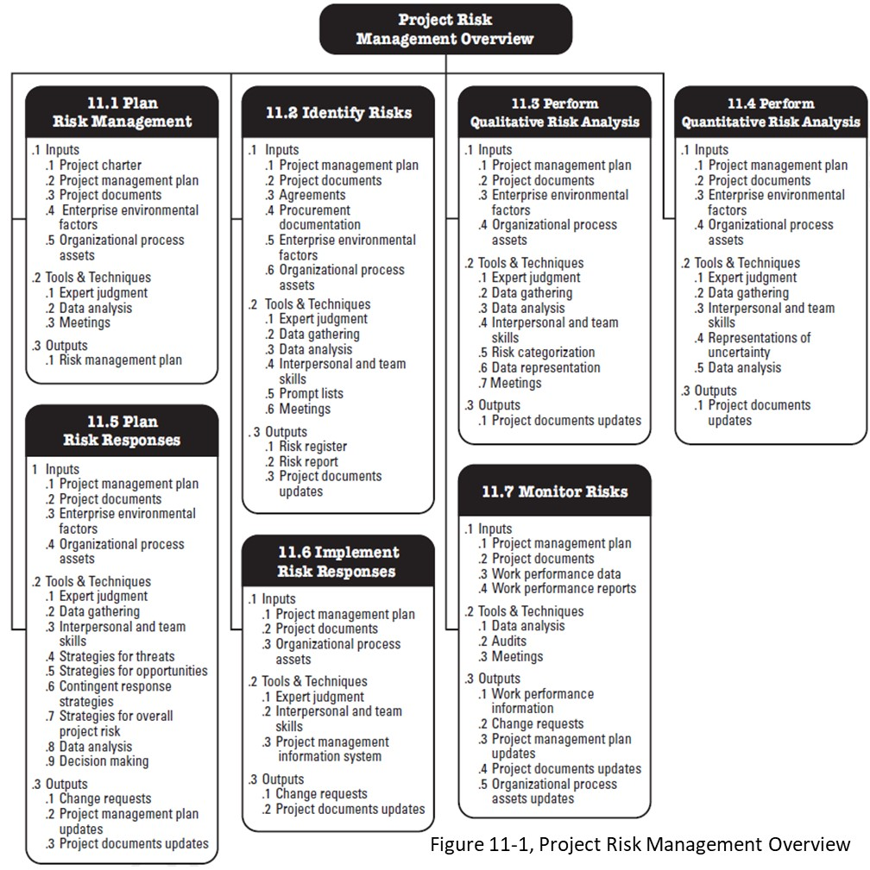
PMBOK
Plan Risk Responses

Slide 4


Risk management process
11.1 Plan Risk Mgt
Develop Risk Register
11.3 Qualitative Risk Analysis
11.4 Quantitative Risk Analysis
11.5 Plan Risk Responses
11.6 Implement Risk Responses
11.7 Monitor Risks
11.2 Identify Risks
Updates?
Updates?
IMPORTANT: Iterative process throughout the entire project life cycle

Slide 5
Objectives of Planning Risk Responses
Reduce the overall risk of the project by decreasing the probability and impact of threats.
Reduce the overall risk of the project by increasing the probability and impact of opportunities.
Plan responses for activities with the highest risk scores and the most common causes of risk.
Be creative in risk responses.
Threats
Opportunities

Slide 6
Inputs to plan risk responses
Risk Management Plan
Risk register so far
Forecast of project schedule and costs
Monte Carlo analysis probability of achieving project objectives (use depends on project), https://www.youtube.com/watch?v=7TqhmX92P6U
Historical risk response records
Risk thresholds

Slide 7
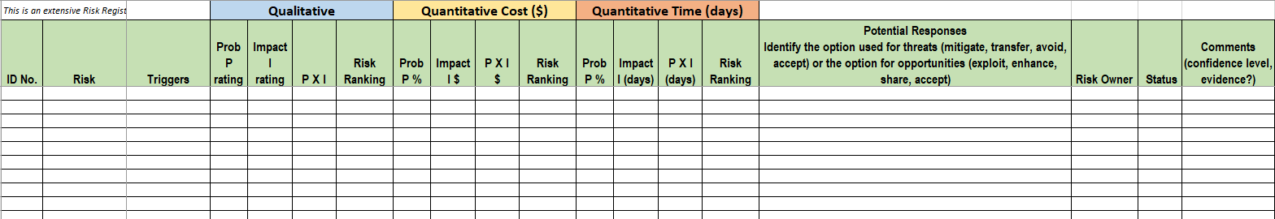
Risk register, so far
Risks have been identified and analyzed both qualitatively and quantitatively.
So far, potential risk responses in the register might just be a note or a reference to more details

Slide 8
How will you plan risk responses?
The approach to planning risk responses should be identified in the Risk Management Plan
For small projects, you could hold a meeting with the project team and stakeholders, and brainstorm.
For medium and large projects, you might organize the risks into categories relating to different functional groups, and then brainstorm.

Slide 9
Threats options for risk response
Threats
Mitigate
Reduce its impact or probability (e.g., more/better quality assurance/control). Consider backup resources.
Avoid
Eliminate the cause (potential risk far exceeds the potential benefits). Consider international supplier.
Accept
“If it happens, it happens” or create a contingency plan. Cost of risk mitigation is higher than cost of risk. Consider collision insurance for an old car.
Transfer
Assign risk to someone else (e.g., by subcontracting or buying insurance).
These 4 strategies above are options for the project team, but a 5th strategy is to “escalate” the risk when the response is above the PM’s authority. For example a very large threat could be escalated to a portfolio manager, and the PM should ensure this person takes over ownership of the risk.
Notes:
For a very large threat -- the project sponsor, portfolio manager or other parties in the organization will want to ensure they take all possible actions to avoid the risk. The negative impact of this risk could easily be outside the scope of the project.

Slide 10
opportunities options for risk response
Opportunities
Enhance
Increase the probability or impact of occurrence (interest in joining from people already on site; be ready to sell umbrellas if it rains at a concert)
Accept
“If it happens, it happens”. We are not going to spend effort/cost on trying to increase probability/impact of it happening.
Exploit
Make the cause more probable – approach 100% probability (e.g., help Green party petition for green energy project)
Share
Retain parts of opportunities (instead of transferring all)
These 4 strategies above are options for the project team, but a 5th strategy is to “escalate” the risk when the response is above the PM’s authority. For example a very large opportunity could be escalated to a portfolio manager, and the PM should ensure this person takes over ownership of the risk.
Notes:
Even though it’s an opportunity, if it’s large enough -- the project sponsor, portfolio manager or other parties in the organization will want to ensure they take advantage of it as the positive impact could go well beyond the scope of the project.

Slide 11

Keep in mind
Risk response strategies must
Be timely (example?)
Not cost more money than the risk would cost
Consider having one response to address several risks.
Involve the team, other stakeholders and experts.
Notes:
Timely can mean done quickly, or done at the appropriate moment in time. An example of NOT being timely is a risk response that takes 2 weeks to put into effect, when the damage from the risk occurs in the first 3 or 4 days.

Slide 12
Response to one risk at Olympics
Handout
Let’s focus on a potential threat at a winter Olympics and identify ONE potential risk response.
Threat: ________________________________
Possible Risk Response | Description
Avoid
Mitigate
Transfer
Accept

Slide 13
Response to risks on Kilimanjaro expedition
Handout
Threat (risk description): ______________________________________
Possible Risk Response | Description
Avoid
Mitigate
Transfer
Accept
Opportunity (risk description): ______________________________________
Possible Risk Response | Description
Exploit
Enhance
Share
Accept

Slide 14
AFTER CREATING RISK RESPONSE
For threats:
Some risks could be eliminated.
Some risks drop out of the list of top risks.
The project management plan is changed to implement the options selected.
Residual threats are determined.
For opportunities:
Opportunities are utilized.
Some risks drop out of the list of top risks.
The project management plan is changed to implement the options selected.
Residual opportunities are determined.

Slide 15

Update the project management plan based on risk responses
Update, change, add work packages.
Update work breakdown structure
Reassign personnel
Update the project definition / scope statement
Update the network diagram and schedule
Update the risk analysis
Update the budget
Update assumptions
Update the management plans
May result in significant changes to the project and its planning!

Slide 16
Cost impact of risk response
The risk responses may result in costs being too high. What can we do?
Use less expensive people with the same skill set.
Cut/reduce scope of work.
Use less expensive equipment with the same capability.
Decrease quality.
Change the schedule.
Decrease profit target.
Outsource part of the work to a less expensive source.
Move some of the work back to the customer.
Eliminate risks in estimates and re-estimate.

Slide 17
impact on Schedule of risk response
The risk responses may result in the schedule being too long. What can we do?
Change the desired schedule end date.
Prove the end date is not realistic based on the details and risk of the project.
Cut activities on the critical path.
Fast track: more activities done in parallel
Crash: make better use of resources, add resource, move resource to different activities.
Eliminate risks and re-estimate.
Go-NoGo Decision
If the options to adjust cost/schedule do not work, the project may be cancelled.

Slide 18
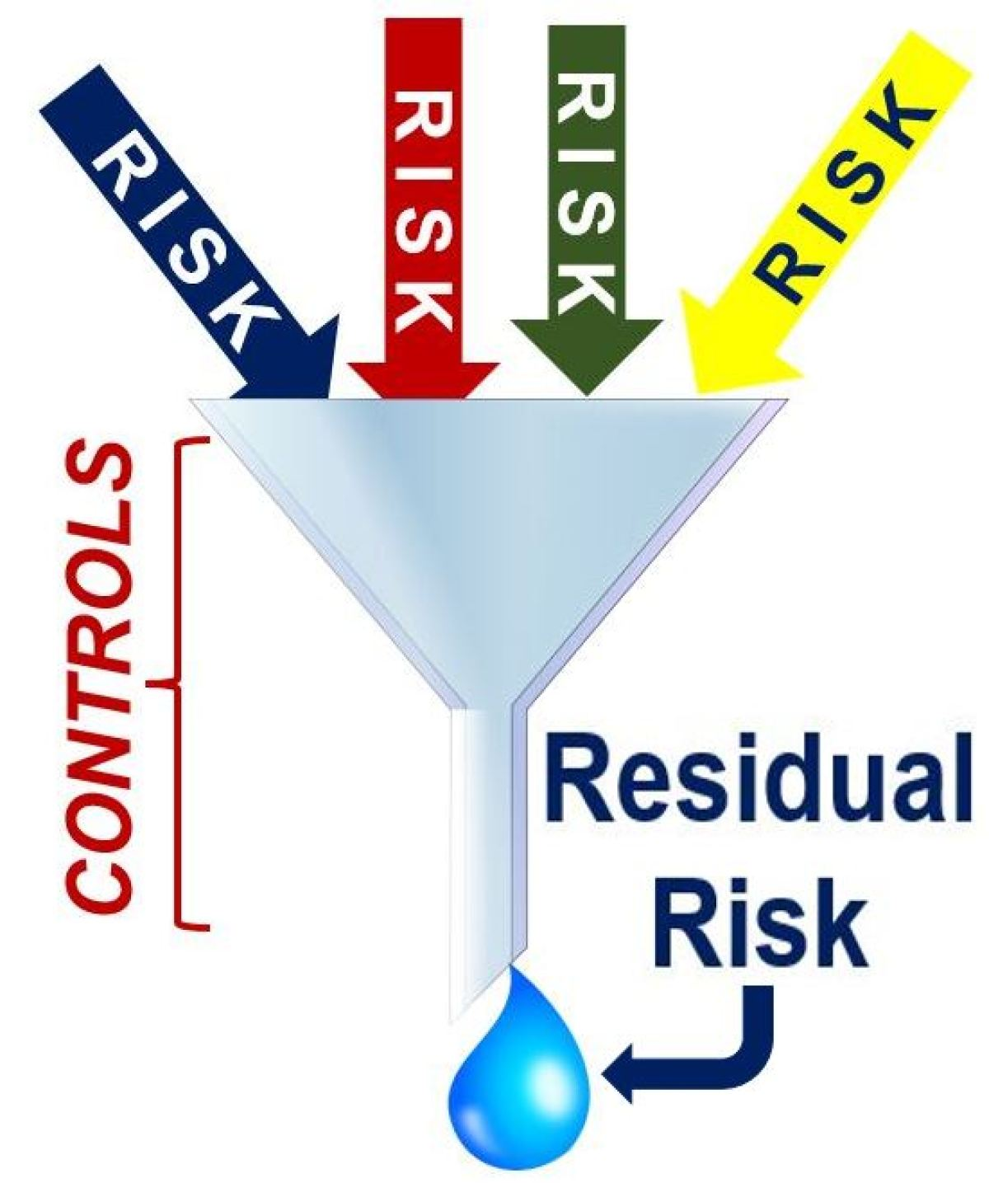
Residual risks
Residual risks: risks that remain after the Plan Risk Responses process
Need contingency plans and fallback plans.
Example: Purchase insurance for flood damage. Residual risk is insurance deductible and risk of insurance company bankruptcy.
Notes:
Image https://marketbusinessnews.com/financial-glossary/residual-risk-definition-meaning/

Slide 19
Risk owner
Risk Owner:
Those who have expertise with the issues relating to the risk or have some responsibility or control over the risk.
They watch for triggers and manage the risk response if the risk occurs.
Risk owner is finalized in the Plan Risk Responses process.

Slide 20
Contingency planning
Planned actions to be taken if the threat or opportunity happens.
If someone becomes sick or injured during the Kilimanjaro expedition, what would be appropriate contingency plan?
Call for emergency medical help. Emergency medical assistance has been advised of your expedition and that you may require assistance. The contact number is carried by guides with phones and radios (mitigate impact).
Wait for emergency assistance to retrieve the injured/sick and make sure all other group members are well enough to proceed (mitigate probability).
Have time allocated in the schedule to allow for this to happen (mitigate impact).

Slide 21
Fallback planning
We need a fallback plan in case the contingency plan fails or only partially works.
Example: For potential public relations risk, have skilled media professionals on call/retainer.
What would be our plan if the contingency plan did not work for our injured hiker on the Kilimanjaro expedition?
If cell phone/radio does not work, have one guide run ahead to get a signal.
If emergency medical assistance arranged is not available, have a back-up emergency medical assistance team arranged.

Slide 22
triggers
An early warning sign that tells the risk owners/project manager that a risk has occurred or is about to occur and contingency plans/fallback pans will need to be implemented.
Document and finalize in the Plan Risk Responses process.
To determine triggers, ask:
What will happen just before this risk occurs?
What can we measure to discover that the risk is about to occur?
How will we know right away when the risk occurs?

Slide 23

triggers
What are some triggers for someone becoming ill (e.g., altitude sickness) during the Kilimanjaro Expedition?
Triggers of altitude sickness
Headache
Nausea and dizziness
Loss of appetite
Fatigue
Shortness of breath
Disturbed sleep
General feeling of malaise
Notes:
Image https://newatlas.com/breath-easy-altitude-sickness/31633/

Slide 24
Secondary risks
A risk that is generated by a response strategy to another risk.
The secondary risks should be included in risk response planning.
What could be some secondary risks for our Kilimanjaro risk response, and contingency plans for those risks?
Secondary Risks:
Emergency response team could become sick or injured during the response.
Guides could become sick or injured running for help or phone signal.
Contingency Plans for Secondary Risks:
Have a secondary emergency response team arranged.
Have first aid equipment to be able to stabilize ill person.
Descend the mountain.

Slide 25
Primary vs secondary vs residual risks
Primary risks are the risks that were identified and typically found on a risk register
Secondary risks are new risks created after a risk response is implemented
Residual risks are the remaining risks from a risk response

Slide 26
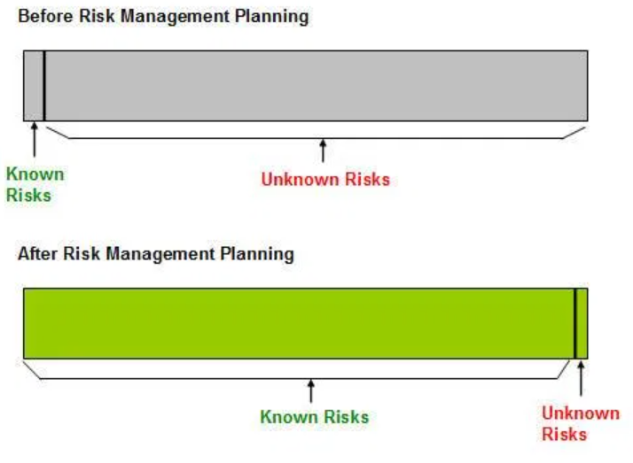
Known vs unknown – the benefit of risk management planning
Notes:
Source https://www.mudassiriqbal.net/known-risk-and-unknown-risks/

Slide 27
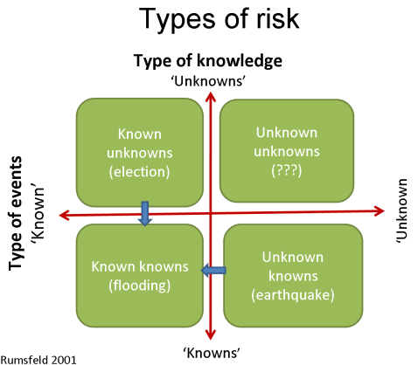
reserves
An amount of time and/or cost (or other element) added to the project to account for risks that cannot be avoided.
Contingency reserves for the “known unknowns” (based on risk analysis performed).
Management reserves for the “unknown unknowns” (usually a percent increase as determined by management).
Notes:
Image https://www.mudassiriqbal.net/known-risk-and-unknown-risks/

Slide 28
Reserve methods
Reserve Method 1: 10 Percent
Add a percent of the project time and cost as a reserve for both contingency reserve and management reserve.
Not recommended as it is not based on risks of the project
Reserve Method 2: Guess
Guess the appropriate amount of time and cost contingency reserve based on the amount and severity of risks. Add it to the time and costs to get the final project schedule and budget. Add a separate reserve based on percentage of project costs.
Not recommended as not defensible to management or customer.

Slide 29
Reserve methods
Reserve Method 3: Expected Monetary Value
Find the expected monetary value (EMV) of the risks to create a contingency reserve. Add a percentage for management reserve. The total is the project budget.
This the preferred method as it is realistic, objective measure and is defendable with management and customer.

Slide 30
Recall EMV example from previous module
Risk | Calculation | Expected Monetary Value of the Cost
A | 0.1 times $150,000 | $15,000
B | 0.3 times $60,000 | -$18,000 (opportunity)
C | 0.7 times $6,000 | $4,200
D | 0.1 times$5,000 | -$500 (opportunity)
E | 0.1 times $16,000 | $1600
 |  | $2,300
Contingency reserve for “known unknowns” would be $2,300 and 16.8 days, based on the EMV of the threats and opportunities.
Risk | Calculation | Expected Monetary Value of the Time
A | 0.1 times 28 days | 2.8 days
B | 0.3 times 56 days | -16.8 (opportunity)
C | 0.7 times 40days | 28 days
D | 0.1 times 14 days | -1.4 days (opportunity)
E | 0.1 times 42 days | 4.2 days
 |  | 16.8 days

Slide 31
Recall EMV example from previous module
You are planning the design of new software. Your project estimate results in a net project cost of CAD $800,000 and 448 days.
A contingency reserve for all threats occurring in their entirety would be $172,000 and 110 days -- this is based on all the threats occurring but none of the opportunities.
 | Question | Answer for Cost
a | Best case | $735,000
b | Management expects | $800,000
c | EMV | $802,300
d | Worst case | $972,000
 | Question | Answer for Time
a | Best case | 378d
b | Management expects | 448d
c | EMV | 464.8d
d | Worst case | 558d

Slide 32
Risk register
Incorporate risk responses into the risk register
Re-determine the probability and impacts with the risk responses in place.
Compare the risk register before and after (risk scores and project risk score should be lower)
Finalized triggers for each risk
Contingency and fallback plans for each risk
Triggers for contingency plan and fallback plans
Finalized risk owners

Slide 33
What else?
Based on risk responses, make a go/no go decision.
Contracts: risk management helps decide what should be subcontracted and what terms and conditions should be in contract.
Proposals: sellers must consider risks and buyers must ask what risks are there on the project
Insurance: Buy if risks include fire, theft or other items that can be insured.

Slide 34
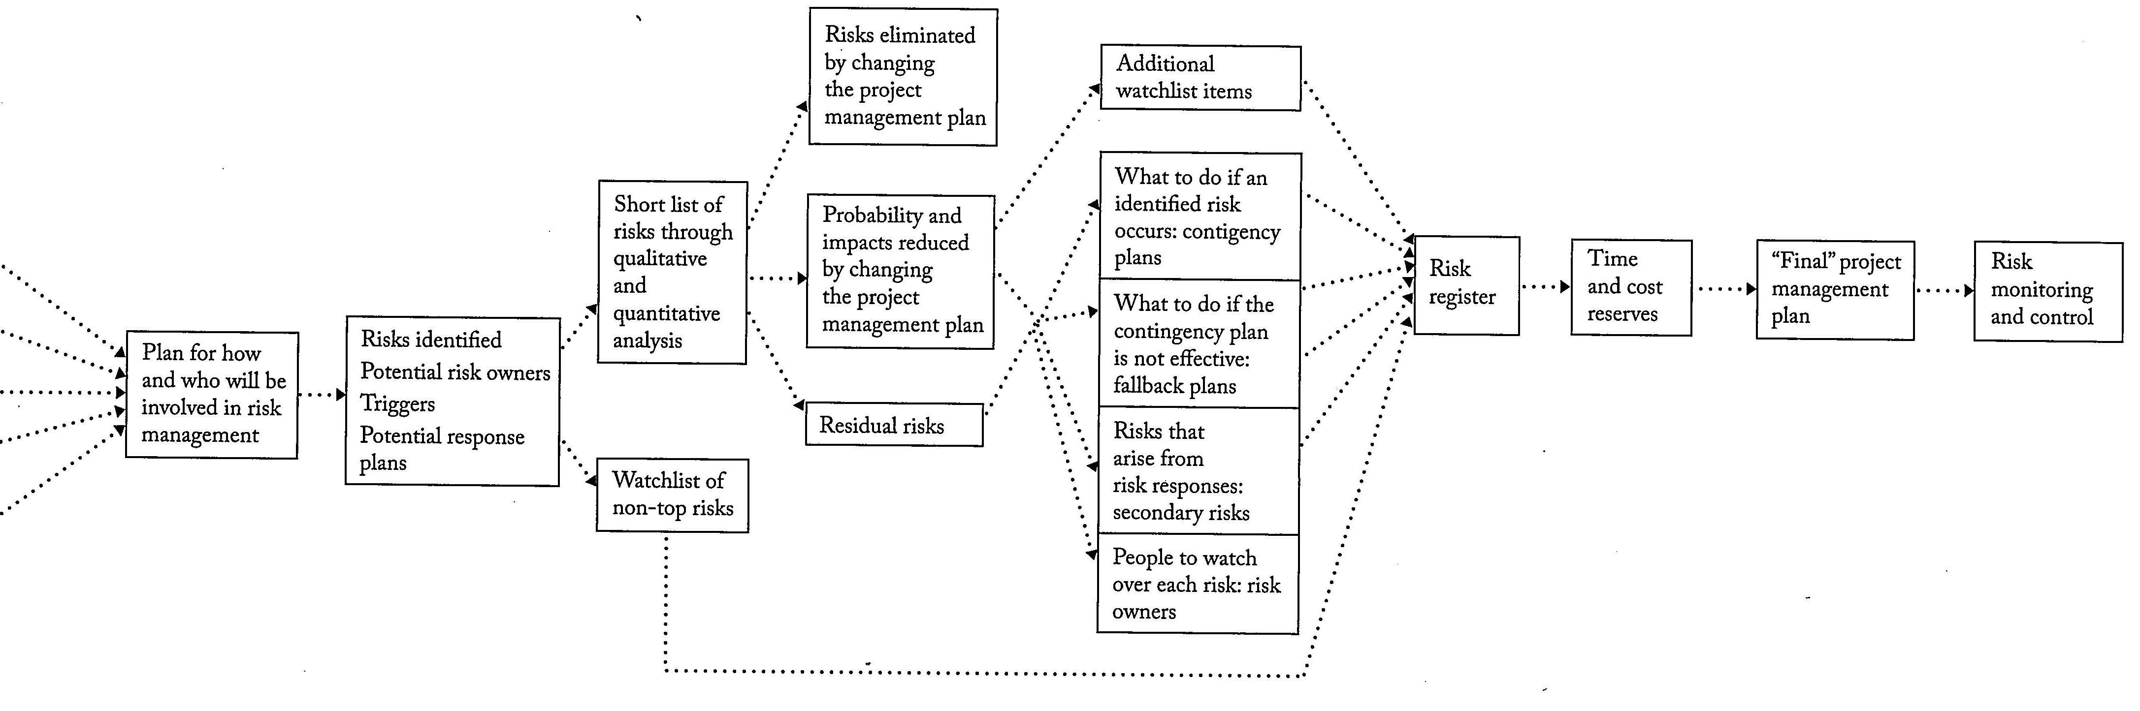
Overview - risk management process
Handout
Inputs
to risk
PMBOK | 11.1 Plan Risk Management | 11.2 Identify Risks | 11.3/11.4 Qualitative and Quantitative Risk Analysis | 11.5 Plan Risk Responses | 11.6 Implement Risk Responses 11.7 Monitor Risks
Flowchart from: Risk Management - Tricks of the Trade for Project Managers by Rita Mulcahy

Slide 35
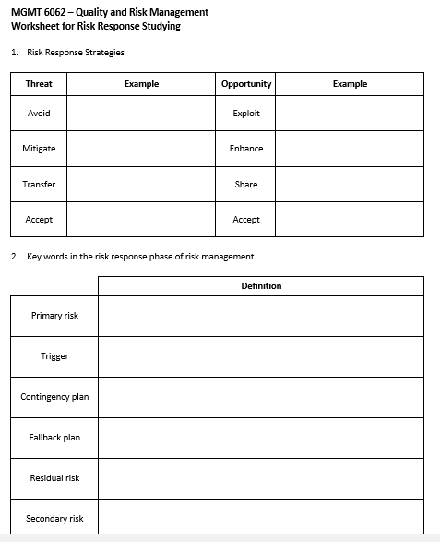
Risk response study sheet
Handout

Slide 36
Homework and evaluations
UpcomingM7 readings per Course at a Glance summary (i.e., readings from Kerzner, PMBOK, Newton)
Assignments and quizzes, check the Course at a Glance and FOL/Content/Course Assignments & FOL/Evaluations/Quizzes
Major risk project due soon
Midterm exam coming up (exam review sheet available on FOL in Module 8)

Slide 37
References
Mulcahy, Rita, and Rita Mulcahy. Rita Mulcahy's Risk Management Tricks of the Trade for Project Managers: And PMI-RMP Exam Prep Guide : A Course in a Book. [Minnetonka, Minn]: RMC Pub., 2010. Print.
A Guide to the Project Management Body of Knowledge (PMBOK® Guide).

